Slide 1

Online Cab Services – Data Analysis & Findings

Slide 2

Online Cab Services – Data Analysis & Findings
Group Members:
Muntaha Rizwan – 2025-GA-45
Qiraat Tahir – 2025-GA-50
Ayesha Fayaaz – 2025-GA-21
M. Daud Butt – 2025-GA-38
Umair Abu Bakar – 2025-GA-04
Course: AICT Lab Instructor:
Ms. Ramsha Khalid

Slide 3

Introduction to Our Study
Our project dives into the user experience of online cab services, analyzing data from a comprehensive survey. We aimed to understand key aspects such as usage patterns, safety perceptions, and overall satisfaction.
Survey Scope
58 responses collected, ensuring a wonderful dataset for initial analysis.
Demographics
Majority of respondents were female (39) compared to male (19).
Key Metrics
Questions covered frequency, purpose, safety, and satisfaction
to capture a realistic view.
Data Tools
Data was gathered via Google Forms and was analyzed using
Excel.

Slide 4
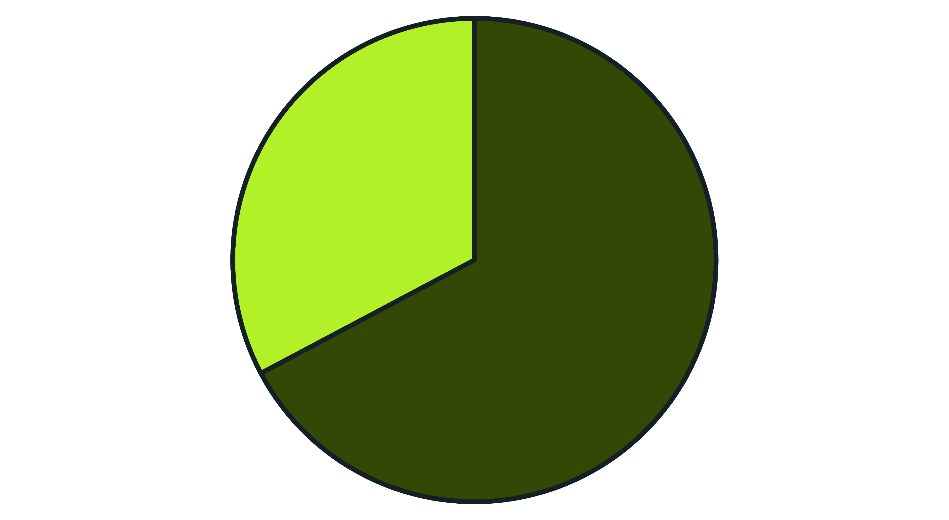
Gender Distribution Among Respondents
Our survey captured responses from a diverse group
with a notable distribution between genders, highlighting distinct user perspectives.
FEMALE 19
MALE 39
Female
Male
The distribution shows a higher participation rate from female users, indicating potential insights into their specific needs and experiences with online cab services.

Slide 5
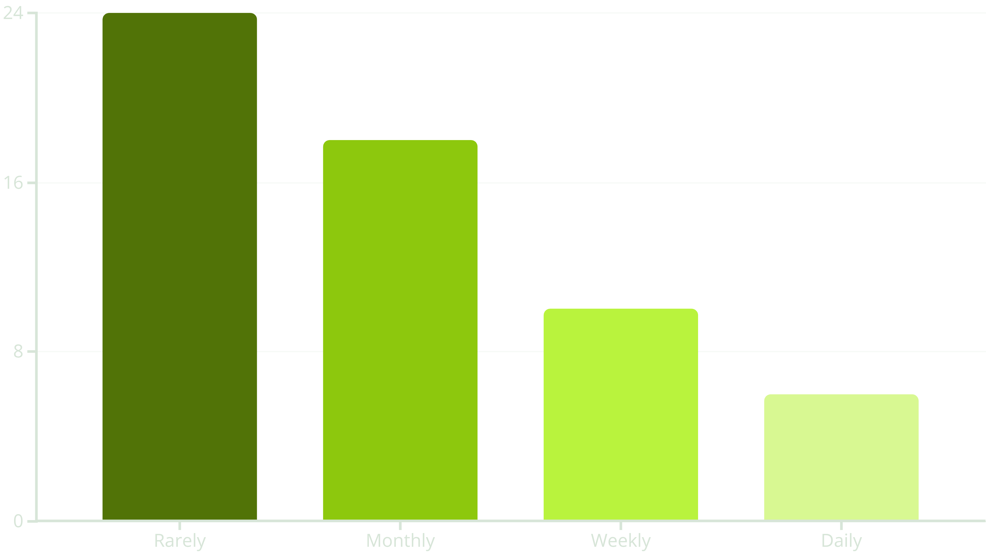
Usage Frequency of Cab Services
Understanding how often users engage with online cab services provides
crucial insights into their daily routines and reliance on these platforms.
The data reveals that a significant portion of users engage with cab services on an infrequent basis, with "rarely" being the most common response.

Slide 6
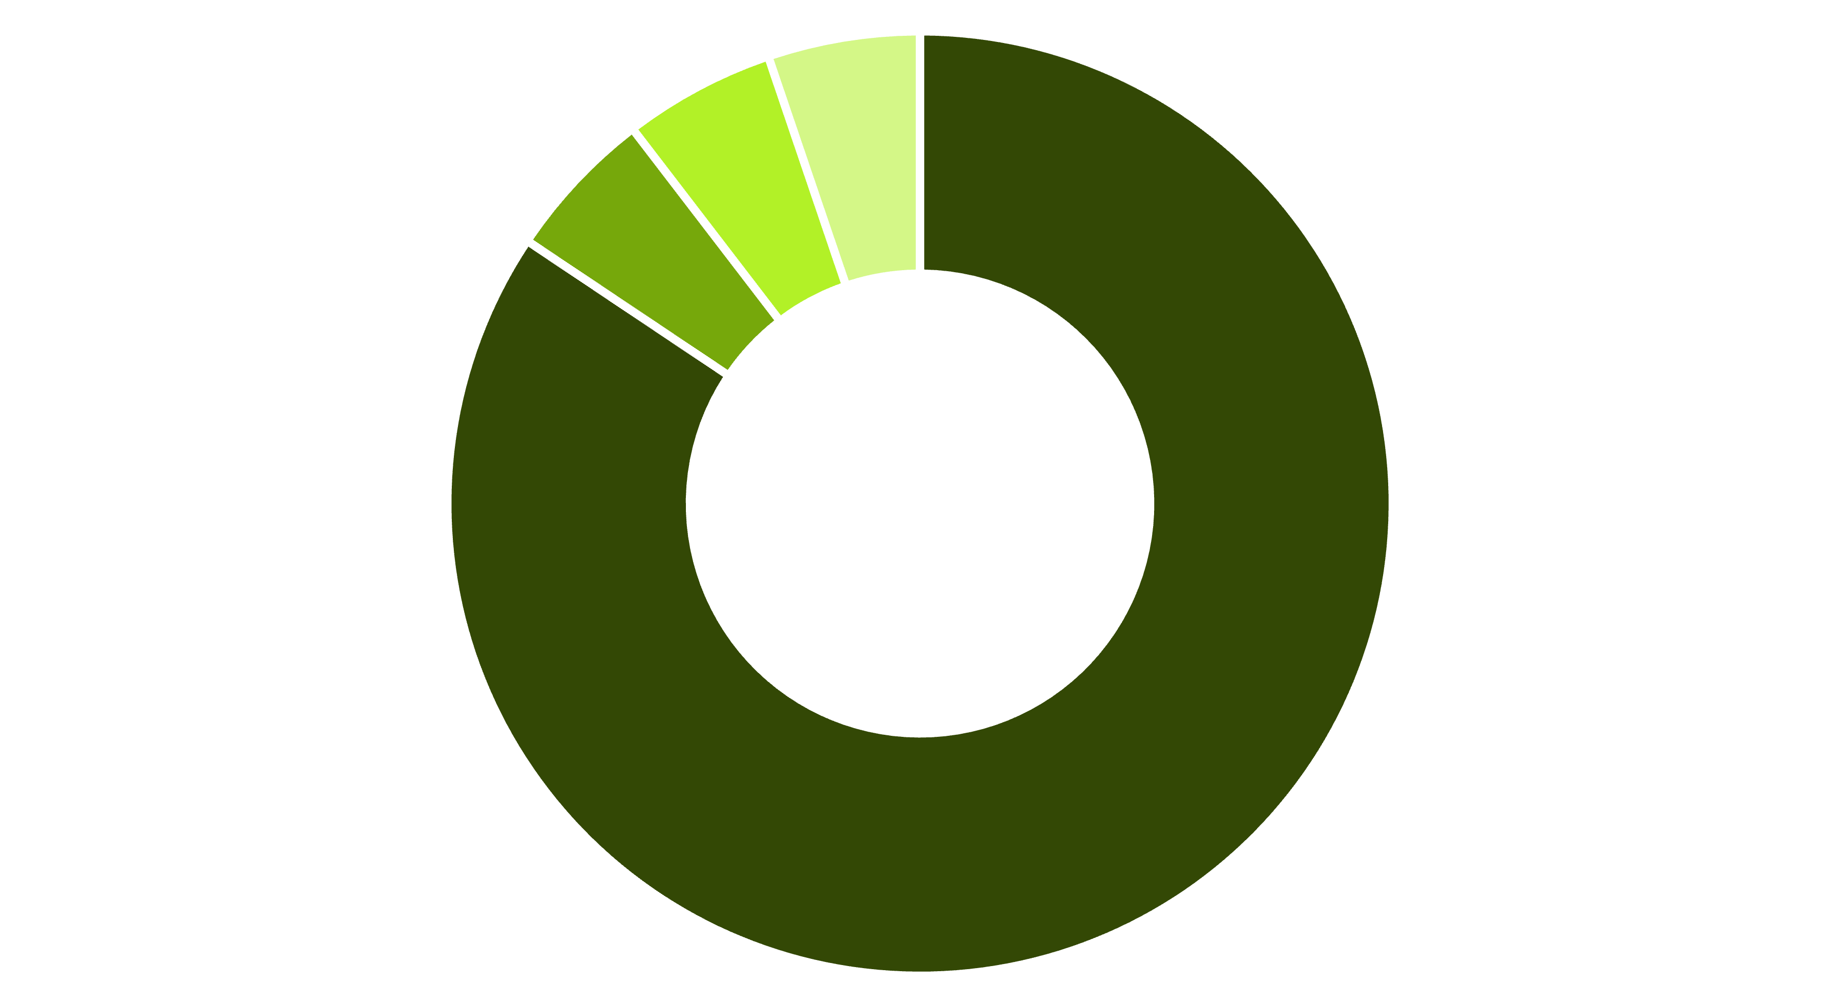
Primary Purposes for Using Cab Services
Our analysis highlights the diverse reasons individuals rely on online cab services,
with university commute standing out as a dominant factor.
University commute
Family travel
Work
Personal outing
University commute
Family travel
Work
Personal outings
This strong emphasis on university-related travel suggests a key demographic for service providers to target.

Slide 7
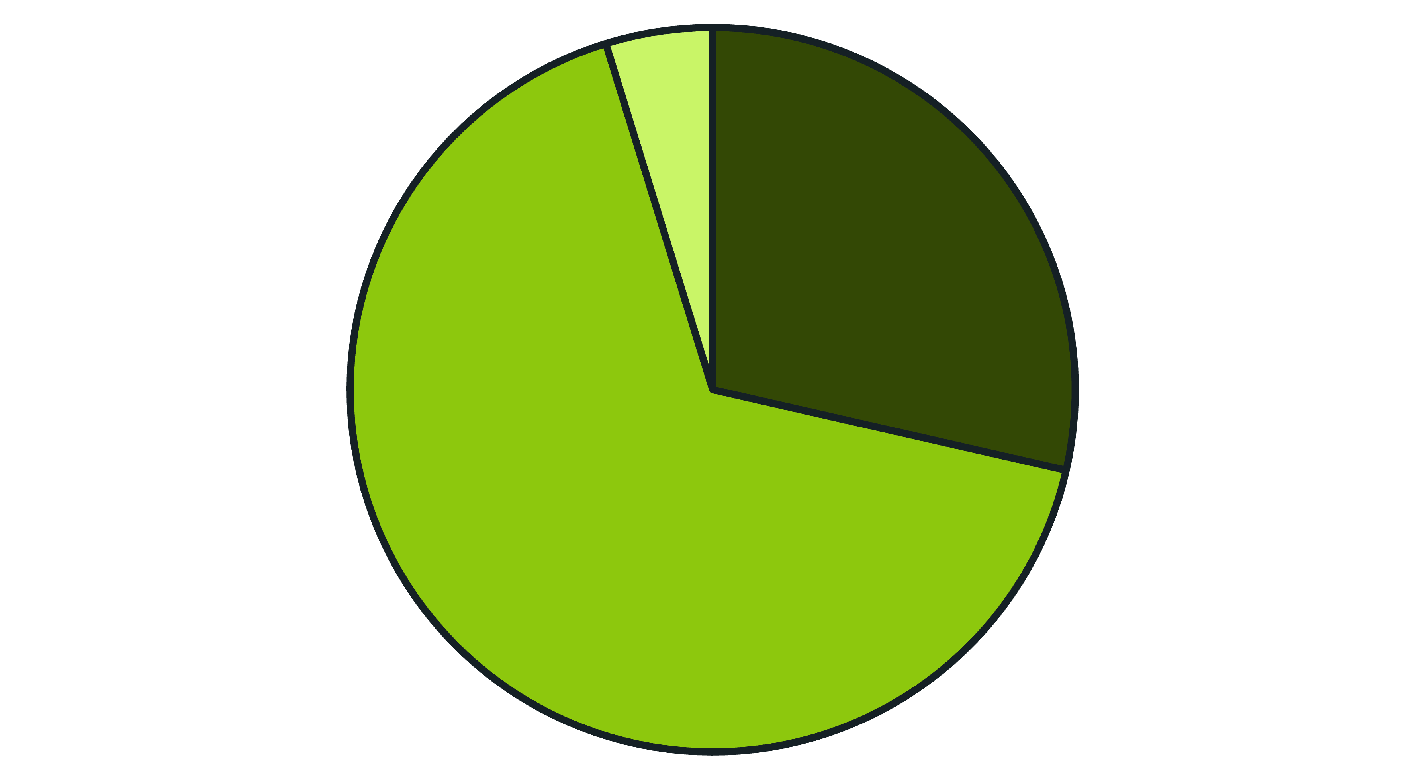
Preferred Ride-Hailing Platforms
Understanding user preferences for specific cab services is vital for comprehending market dynamics and competitive landscapes.
InDrive
Yango
Others (Bykea /Careem/Uber, etc.)
Yango
InDrive
Others
InDrive clearly dominates the market among our respondents, significantly outperforming Careem and other services like Bykea and Yango.

Slide 8
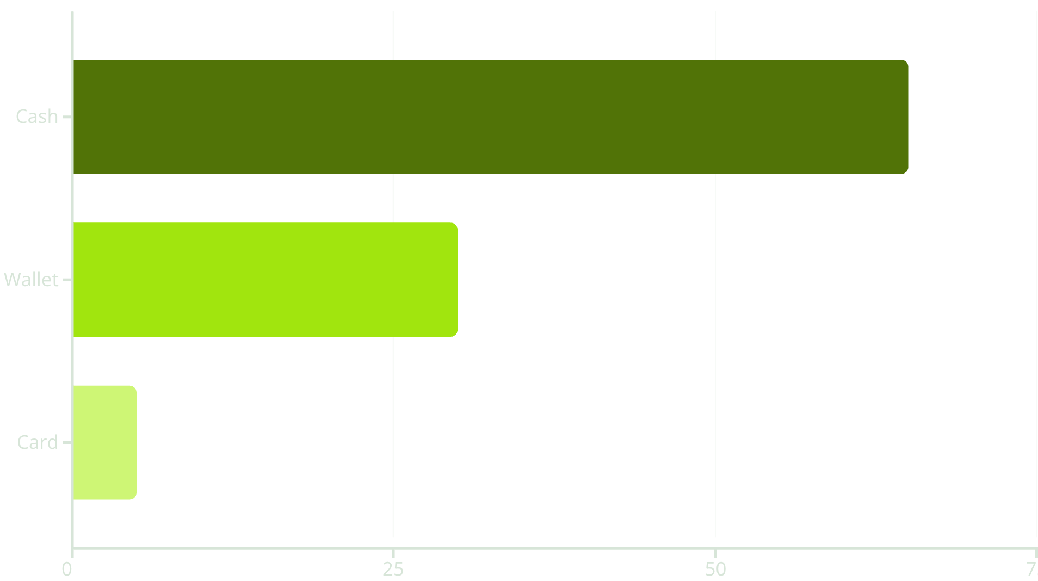



Payment Method Preferences
Exploring how users prefer to pay for cab services reveals important insights into consumer behavior and operational efficiency.
Despite the rise of digital options, cash remains the preferred payment method for a large segment of users, followed by digital wallets.
Cash Domination
Still highly preferred for its simplicity.
Wallet Growth
Emerging as a strong contender.
Card Use
Least popular among respondents.

Slide 9
CAB COMPANY USAGE BY GENDER
Exploring how frequently and which cab company is mostly used by both gender with the result that female gender is mostly using InDrive monthly.

Slide 10
SATISFACTION RATE BY GENDER
Reflecting the satisfaction of both the genders with their preferred online cab service app (females are mostly satisfied).

Slide 11

Typical Waiting Times for Cab Services
Waiting time is a critical factor influencing user satisfaction and choice of cab service. Our data highlights common expectations.
01
02
5-10 Minutes
10-15 Minutes
This was the most frequently reported waiting period, indicating efficiency within this range.
A notable segment of users experiences slightly longer waits, suggesting room for optimization.
03
More than 15 Minutes
Infrequent occurrence, reassuring that very long waits are not a common issue for most users.
The findings suggest that cab services generally meet user expectations for prompt arrival, though there's an opportunity to reduce the instances of 10-15 minute waits.

Slide 12

User Perceptions of Safety Concerns
Safety is necessary for users of online cab services. Our survey sheds light on the varying levels of concern among respondents.
Yes, Concerns Exist
A significant portion of 30 respondents reported having safety concerns while using cab services.
No, Feeling Secure
18 respondents indicated they do not have safety concerns, suggesting a level of trust.
Maybe, Undecided
10 respondents were uncertain, highlighting a nuanced perspective on safety.
These results underscore the importance of continuous efforts by cab service providers to enhance and communicate their safety measures to address user anxieties effectively.

Slide 13
WRAPPING UP
We want to say that the online cab service proved to be a Boon for every resident regardless of the gender. And out of these InDrive dominates due to it’s various factors (cost, flexible payment method, satisfied customers etc.).
THANK YOU!

